Slide 1
Lesson 10 Project: my Giphy App (part I)
Martynas Bieliakas

Slide 2
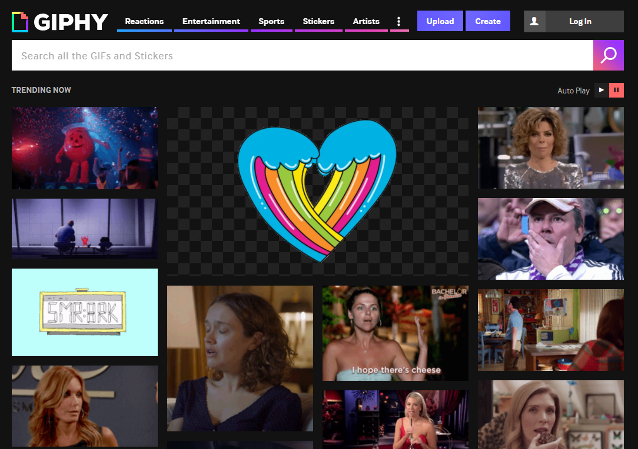
What the hell is Giphy.com?
It’s a website that has lots of gifs…
Sooo… We’re doing our own Giphy like app ☺
Project: Giphy app

Slide 3
OK… Why should we do this?
We’ll test our JavaScript and Frontend skills.
We’ll learn a bit more about JavaScript.
We’ll learn real life development flows, tools and techniques.
And we’ll have some fun along the way ☺
Project: Giphy app

Slide 4
How will we do it?
Giphy API
Our own web app with HTML, CSS and JS.
HTTP requests to get the data from the API.
Project: Giphy app

Slide 5
What we’ll need to before we start?
Node.js and npm
Go to https://nodejs.org/en
Download and Install node.js on your machine
It will automatically install npm on your machine too
(bank security…)
Giphy API key:
Go to https://developers.giphy.com/
Click on “Create an App”, write down the app name and other stuff
You got yourself a Giphy API key! ☺
Check what endpoint to call https://developers.giphy.com/explorer/
Project: Giphy app

Slide 6
Planing the app
We’ll need a page to run our app.
Styling – we’ll want our app to look good(-ish).
Communication with API– we’ll need a way to communicate with the Giphy API.
Search – we’ll need to be able to search and retrieve gifs.
Displaying – we’ll need to dynamically create and add gifs to the page.
Models – what data structures will we need.
Handling events (clicks and stuff)
Project: Giphy app

Slide 7
How to create an app structure?
Option 1: We could import separate scripts into index.html.
Easy to do – just add all stuff via <scripts> tag.
Hard to handle dependencies
Synchronous calls block page rendering
Project: Giphy app

Slide 8
How to create an app structure?
Option 2: Use modules.
A bit harder to setup and understand at first
Easy to handle dependencies
Works asynchronously so doesn’t block the page.
Project: Giphy app

Slide 9
JavaScript Modules
Problems:
Web sites are turning into Web apps
Code complexity grows as the site gets bigger
Assembly gets harder
Developer wants discrete JS files/modules
Project: Giphy app

Slide 10
JavaScript Modules
Front-end developers need a solution with:
Some sort of #include/import/require
Ability to load nested dependencies
So in a nutshell: what are JavaScript modules? What is their purpose?
Definition: how to encapsulate a piece of code into a useful unit, and how to register its capability/export a value for the module.
Dependency References: how to refer to other units of code.
Project: Giphy app

Slide 11
JavaScript Modules
Time’s short so:
Eloquent JavaScript https://eloquentjavascript.net/10_modules.html
RequireJs (we’ll be using it in our project) https://requirejs.org/docs/why.html
Let’s look at an example of basic RequireJs setup.
Project: Giphy app

Slide 12
So let’s create a basic structure
Let’s get the template from RequireJs:
https://github.com/volojs/create-template
And we’re going to modify it a little bit to suit our needs.
Project: Giphy app

Slide 13
Promises
Working with abstract concepts is often easier when those concepts can be represented by values.
In the case of asynchronous actions, you could, instead of arranging for a function to be called at some point in the future, return an object that represents this future event.
A promise is an asynchronous action that may complete at some point and produce a value. It is able to notify anyone who is interested when its value is available.
Project: Giphy app

Slide 14
Fetch API
fetch() allows you to make network requests similar to XMLHttpRequest (XHR).
The main difference is that the Fetch API uses Promises, which enables a simpler and cleaner API, avoiding callback hell and having to remember the complex API of XMLHttpRequest.
Project: Giphy app

Slide 15
Async/await
An async function is a function that implicitly returns a promise and that can, in its body, await (wait for them to resolve or fail) other promises in a way that looks synchronous.
An async function is marked by the word async before the function keyword. Methods can also be made async by writing async before their name. When such a function or method is called, it returns a promise.
Inside an async function, the word await can be put in front of an expression to wait for a promise to resolve and only then continue the execution of the function.
Project: Giphy app

Slide 16
Debugging
Stuff breaks.
In developer tools (F12) there is Sources tab (Chrome) and Debbuger tab (Firefox) you can place a breakpoint and see what in what state is the app currently.
More on this:
https://developer.mozilla.org/en-US/docs/Tools/Debugger
and
https://developers.google.com/web/tools/chrome-devtools/javascript/
Project: Giphy app

Slide 17
What should you do?
Use the basic-template as a starting point for your Giphy app.
Put all JS code or modules to the app folder.
In the app folder try to structure code/files to models (data contracts), services (classes that do something for the app a.k.a business logic), http clients (classes that do the communication with the Giphy API). Use modules.
Your app’s entry point is in app/main.js.
Write your app! ☺
Or you can try doing any some other way.
Project: Giphy app

Slide 18
Goal
The main goal of this project is to test and strengthen what you have learned from all the lessons.
Expect that you will need to google stuff, read about modules, promises and async/await ☺ contact me if you’re really stuck.
Don’t get stuck on styling too much. CSS whole another topic. Use flexbox for layout, the rest is up to you. A good flexbox tutorial https://internetingishard.com/html-and-css/flexbox/
Vital part of programming in any language is to read code. So read my implementation or some other solution, to get some inspiration.
Project: Giphy app

Slide 19
The end result
Really simple:
App should be able to search and then load giphy data from Giphy API.
Extract gif and other data and populate view with gif images.
Let the user load more results if he wants (on the same search keyword).
Page should have some sort of navigation. If you click on a navigation item – it will search/load gifs by a predefined keyword.
Good luck!
Project: Giphy app

